Slide 1
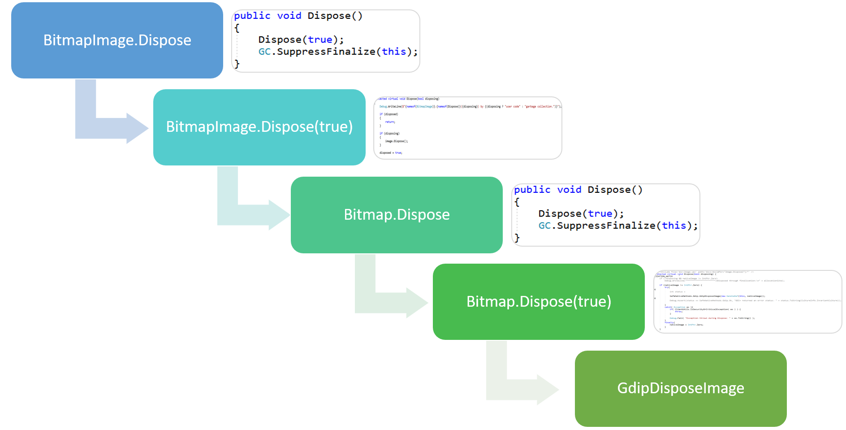
.NET GC – Understanding IDisposable
By David Anderson, DCOM Engineering, LLC

Slide 2
GC Memory Quickstart
Managed Memory
Unmanaged Memory
Unmanaged memory is typically allocated by platform invoke methods to open native resources
This memory is not managed by the Garbage Collector or runtime and must be explicitly freed by the developer
Managed memory is typically allocated when you create a new object()
This memory is completely managed by the Garbage Collector and runtime
Finalizers / Destructors
Allows final cleanup of an object before the object is destroyed, in the event Dispose is never called. If Dispose is called, it is not necessary for a finalizer to run.
.NET GC – Understanding IDisposable by David Anderson

Slide 3
IDisposable
You implement IDisposable when you create a class that holds references to unmanaged resources
How do I know I have unmanaged resources?
If your class holds a reference to an object that also implements IDisposable
FileStream
Bitmap
et cetera
If you use platform invoke to directly create native resources, such as opening a file
If you allocate native memory directly via Marshal.AllocHGlobal or similar
.NET GC – Understanding IDisposable by David Anderson

Slide 4
Dispose (Deterministic)
You call BitmapImage.Dispose directly in code
Reference count does not have to be 0 for this to occur
Managed memory may not be reclaimed if the reference count is greater than 0, but the unmanaged resources will still be freed.
This is one reason why it is important to make Dispose safe to call multiple times, and why you should also throw ObjectDisposedException from members that are no longer safe to use after resources are disposed
Finalization is suppressed because there is no need for it to run now
Unmanaged resources are freed immediately
.NET GC – Understanding IDisposable by David Anderson

Slide 5
Basic Dispose Pattern
BitmapImage.Dispose
BitmapImage.Dispose(true)
Bitmap.Dispose
Bitmap.Dispose(true)
GdipDisposeImage
.NET GC – Understanding IDisposable by David Anderson

Slide 6
Basic Dispose Pattern
public class BitmapImage : IDisposable
{
private bool disposed;
private readonly Bitmap image;
public BitmapImage(Bitmap image)
{
this.image = image;
}
public void Dispose()
{
Dispose(true);
GC.SuppressFinalize(this);
}
protected virtual void Dispose(bool disposing)
{
if (disposed)
{
return;
}
if (disposing)
{
image.Dispose();
}
disposed = true;
}
}
BitmapImage.Dispose
BitmapImage.Dispose(true)
Bitmap.Dispose
Bitmap.Dispose(true)
GdipDisposeImage
.NET GC – Understanding IDisposable by David Anderson

Slide 7
Basic Dispose Pattern
BitmapImage.Dispose
BitmapImage.Dispose(true)
Bitmap.Dispose
Bitmap.Dispose(true)
GdipDisposeImage
public void Dispose() {
Dispose(true);
GC.SuppressFinalize(this);
}
protected virtual void Dispose(bool disposing) {
if (nativeImage != IntPtr.Zero) {
try {
SafeNativeMethods.Gdip.GdipDisposeImage(new
HandleRef(this, nativeImage));
}
finally {
nativeImage = IntPtr.Zero;
}
}
}
.NET GC – Understanding IDisposable by David Anderson

Slide 8
Dispose (Indeterministic)
You do not call BitmapImage.Dispose directly in code
Reference count needs to be 0 for this to occur
Typically will occur when there is enough managed memory pressure / allocations to cause the GC to run, but you will not know exactly when this will happen
You will likely run out of unmanaged memory before enough managed memory is allocated to cause this
Finalizer will be scheduled in the Finalization thread / queue
Unmanaged memory will be freed when the finalizer is removed from the queue
Should be considered a memory leak
.NET GC – Understanding IDisposable by David Anderson

Slide 9
Basic Dispose Pattern without explicit Dispose call
Ref Count = 0 / Memory Pressure / GC Algorithms
GC
~Bitmap()
Bitmap.Dispose(false)
GdipDisposeImage
.NET GC – Understanding IDisposable by David Anderson

Slide 10
Basic Dispose Pattern without explicit Dispose call
public class BitmapImage : IDisposable
{
private bool disposed;
private readonly Bitmap image;
public BitmapImage(Bitmap image)
{
this.image = image;
}
public void Dispose()
{
Dispose(true);
GC.SuppressFinalize(this);
}
protected virtual void Dispose(bool disposing)
{
if (disposed)
{
return;
}
if (disposing)
{
image.Dispose();
}
disposed = true;
}
}
BitmapImage.Dispose
BitmapImage.Dispose(true)
Bitmap.Dispose
Bitmap.Dispose(true)
GdipDisposeImage
.NET GC – Understanding IDisposable by David Anderson

Slide 11
Basic Dispose Pattern without explicit Dispose call
BitmapImage.Dispose
BitmapImage.Dispose(true)
Bitmap.Dispose
Bitmap.Dispose(true)
GdipDisposeImage
public void Dispose() {
Dispose(true);
GC.SuppressFinalize(this);
}
protected virtual void Dispose(bool disposing) {
if (nativeImage != IntPtr.Zero) {
try {
SafeNativeMethods.Gdip.GdipDisposeImage(new
HandleRef(this, nativeImage));
}
finally {
nativeImage = IntPtr.Zero;
}
}
}
.NET GC – Understanding IDisposable by David Anderson

Slide 12
Dispose (Indeterministic, Finalizer)
This is the same as the slide for Dispose (Indeterministic), but when you hold native resources yourself and not a managed object that holds those resources and implements IDisposable.
Same rules apply.
.NET GC – Understanding IDisposable by David Anderson

Slide 13
Basic Dispose Pattern without explicit Dispose call
Ref Count = 0 / Memory Pressure / GC Algorithms
GC
~BitmapImage()
BitmapImage.Dispose(false)
GdipDisposeImage
.NET GC – Understanding IDisposable by David Anderson

